Slide 1
Snowpark Hands-on Lab Overview
APRIL 2023

Slide 2
Agenda
Snowpark Overview (5 min)
Hands-On Lab Data and Flow (5 min)
Use Visual Studio Code to complete hands-on lab
Next Steps: Snowflake for Data Engineering (10 min)
Notes:
TKO Notes
Customer facing version of what we just talked about

Slide 3
Snowpark Overview

Slide 4
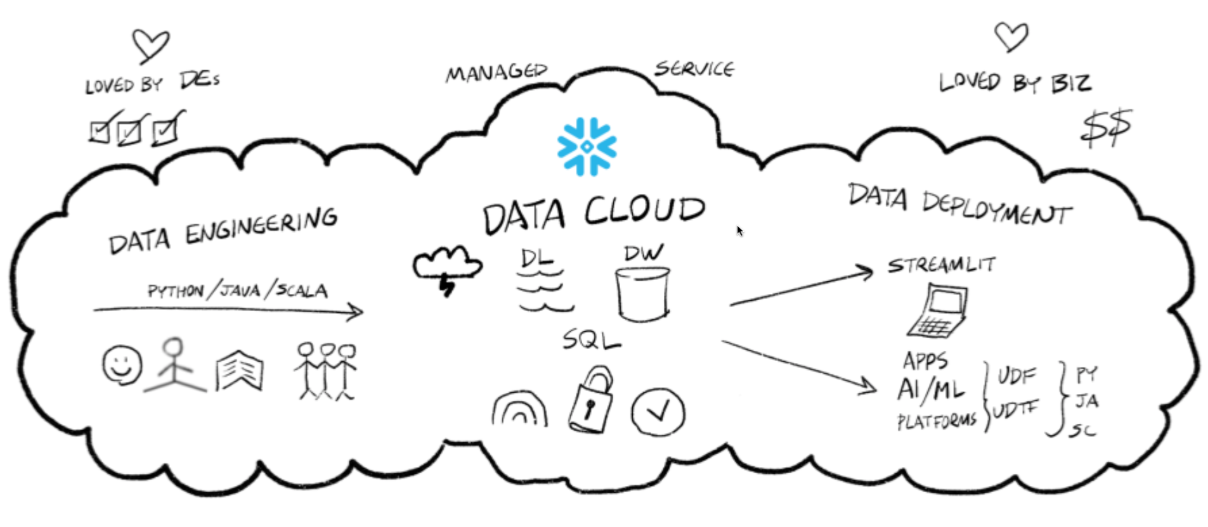
Snowflake: Why did we create Snowpark?

Slide 5
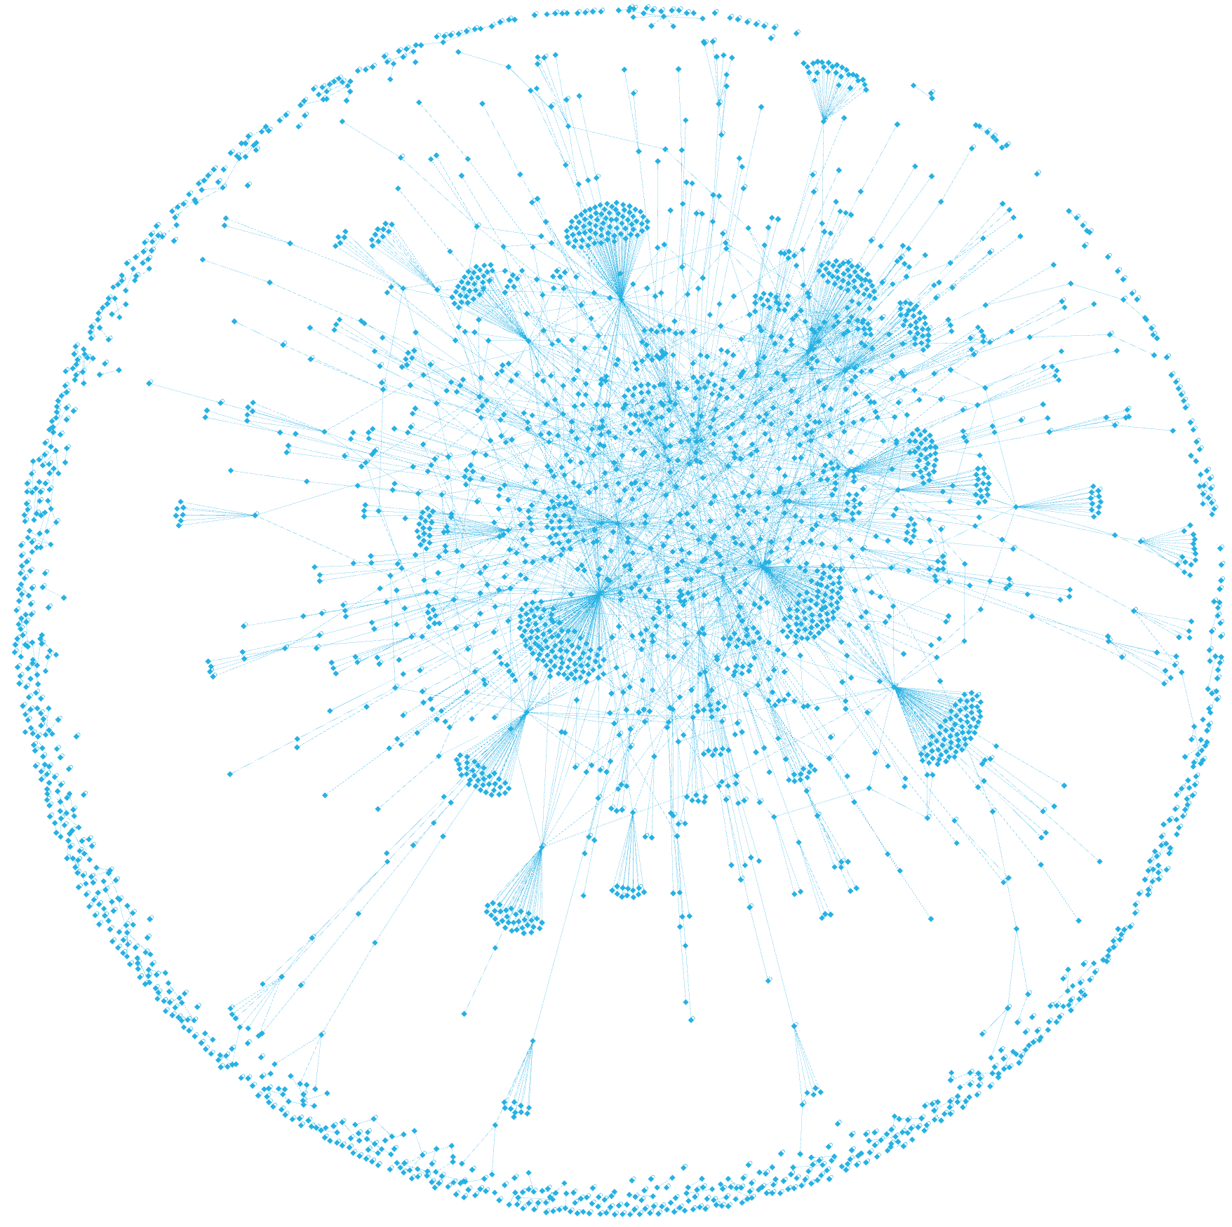
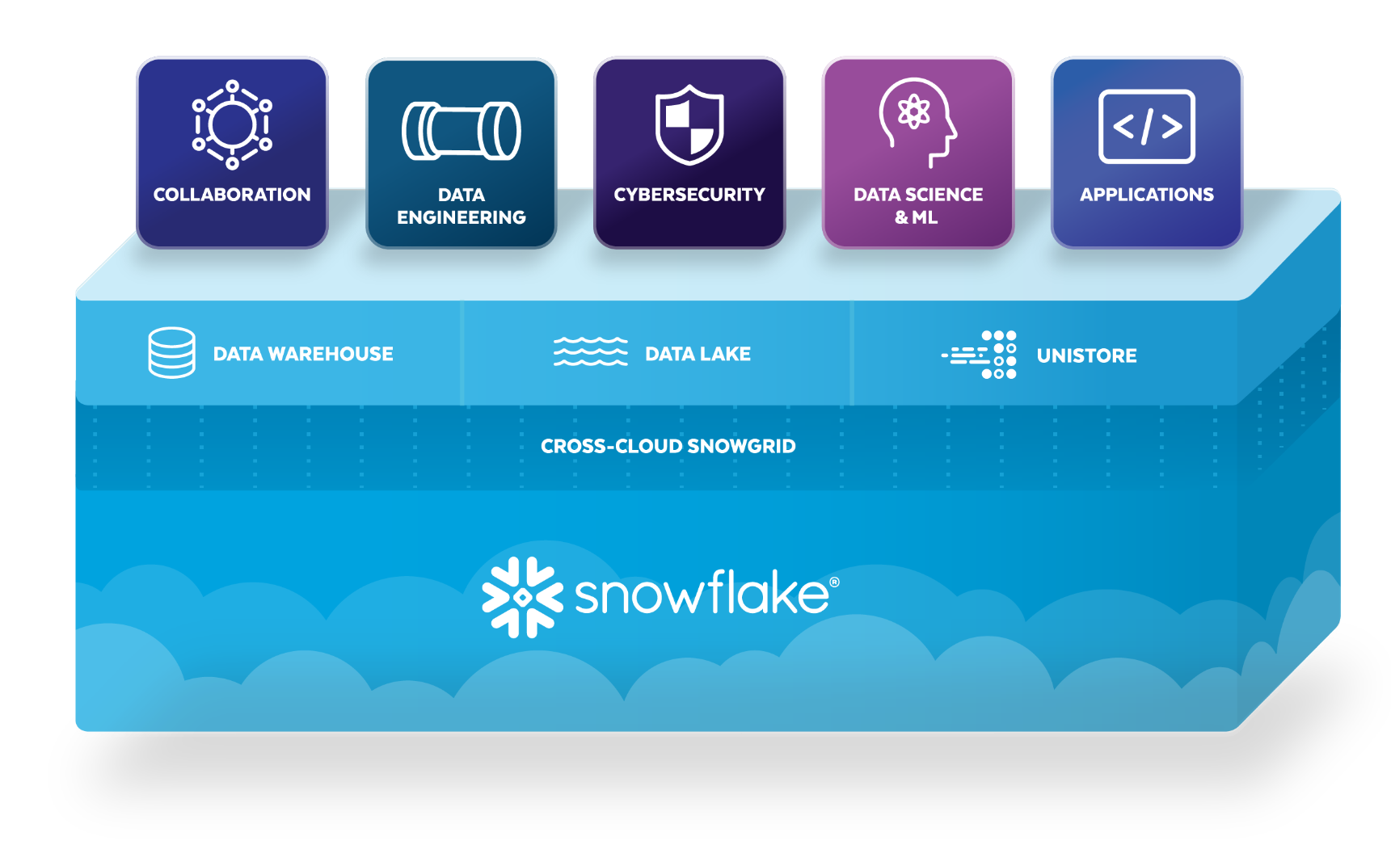
Data Cloud for Data Engineering and Data Science
Platform
Simple, reliable data pipelines in the language of your choice
3rd Party
Data
SaaS
Data
Customer
Data
Data + Services + Apps
Partner
Data
Applications
Data
Services

Slide 6

Streamlined Architecture with Snowflake
One single platform with native support for different languages
Simpler capacity management and resource sizing
Streamlined architecture and collaboration on the same data
Consistent governance and security policies
User 1
User 2
DATA + CREDENTIALS
DATA + CREDENTIALS
CLOUD STORAGE
Notes:
We can make it much more simplified, and run this entire pipeline all directly in Snowflake
Developers of different skill set can collaborate and we can streamline the architecture. All with great cloud speed and elasticity.
Singular platform will bring easy governance and control. This way you get faster time to market new projects and products

Slide 7

Snowpark for Data Engineering and Data Science
ETL/ELT
Ingestion and transformation to bring raw data into modeled format
Custom Logic
Custom code for industry specific transformations, quality checks or automation rules
Data Science & Machine Learning Pipelines
Pipelines feeding ML models that require custom transformations and commonly use third-party OS libraries

Slide 8

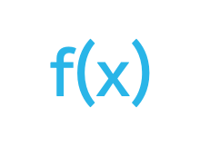


Snowpark for Data Engineering and Data Science
COPY
Snowpipe (auto-ingest)
BI / Analytics
Structured
Code in your preferred way with Snowpark*
Kafka connector
Data Sharing
Data Science
Semi-structured
Transformations using ANSI SQL
Stored procedures
Schema Detection*
Data Lake export
Partners
Streams & tasks
capture and react to changes
Execute effortlessly with Serverless Tasks*
Customers
Unstructured*
Ingestion Dashboard*
Common drivers
Ingestion
Transformation
Delivery
* In Preview

Slide 9
Code the Same Way, Execute Faster with Snowpark
SNOWPARK
Client-Side
SQL
SCALA
PYTHON
JAVA
OTHER
JAVA
PYTHON
JAVASCRIPT
EXTERNAL
Server-Side
SQL
SNOWFLAKE PROCESSING ENGINE
Notes:
Snowpark is a new developer framework for Snowflake. It allows data engineers, data scientists and data developers to code in their familiar way with their language of choice, and execute pipeline, ML workflow and data apps faster and more securely, in a single platform.
It brings deeply integrated, DataFrame-style programming to the languages developers like to use, and functions to help you expand more data use cases easily, and now all these can be executed inside of Snowflake using the elastic performance engine.
Snowpark for all languages in GA - production ready
Snowpark opens up data programmability and extensibility.

Slide 10
Why Snowpark
Language of Choice
Enable all data users to bring their work to a single platform with native python, java, scala and SQL support
No Governance Trade-offs
Apply consistent controls trusted by over 500 of the Forbes Global 2000 across all workloads
Faster & Cheaper Pipelines
Migrate existing Spark pipelines with minimal code change, better price-performance, transparent cost and less ops overhead
Customers transitioning from Spark-based pipelines are reporting that Snowpark is up to 2-3x faster at 30-50% of the cost.
Notes:
Single platform : There are lots of complexity in architecture with different teams using different languages, having to spin up multiple processing engines and clusters. Snowpark brings all teams to collaborate on the same data in a single platform, which streamlines architecture by natively supporting everyone’s programming language of choice, with no need for separate processing engines, so different code can run in Snowflake directly.
SQL users to all users and scale : With Snowpark, the benefit of Data Cloud extends from SQL users to all your data teams. They too can leverage the power of the elastic performance engine, build scalable, optimized pipelines, apps, and machine learning workflows with superior price/performance and near-zero maintenance.
Security controls and Governance: Snowpark is secure by default where administrators have full control over the libraries are allowed to execute. The runtime on Snowflake’s compute clusters do not have access to the network and therefore avoid problems like unwanted network access. Again, all in a single, secure platform where governance control and security policies are consistent so you can act with confidence by removing data security and compliance barriers to production with consistent, enterprise-grade governance controls and security across all your workflows.

Slide 11
Hands-On Lab Data and Flow
Notes:
TKO Notes
The purpose of this section is two-fold:
Instill confidence that we’ve been successful doing this with many customers already
We have a very well-defined process that will help the customer make a data-driven decision with regards to their Data Engineering workloads
Again, we are selling them on the ease of evaluating and migrating their code

Slide 12

Hands-on Lab Objective
Predict future ROI (Return On Investment)
Raw Data
Historical Purchases / Transactions
Website activity
Profile details
Membership status
…
Features
per user id:
Sum_purchases_last_7_ days = 150
Count_items_bought_last_7_days = 22
Has_visited_site_last_30_ days = 1
Is_diamond_member = 1
Model
Linear Regression
Prediction
Predict future ROI value
($0 to $1M)
Business Action
Data Wrangling

Slide 13
Hands-on Lab Flow
Effortless, scalable and secure processing without data movement across compute environments
Prepare & Transform
Train
Inference
model
data lake
DATAFRAME: ________
________
________
________
training data
SPROC(): ________
________
________
________
UDF(
Max_batch_size = n
________
________
________
):
predictions
Stage
standard warehouse
Medium Snowpark-optimized warehouse
multi-node standard warehouse
inference data
ML Training Tip:
Use UDTFs to train multiple models concurrently using M-4XL Snowpark-optimized warehouse
ML Inference Tip:
Speed up inference using Vectorized UDFs to process rows in batches & cachetools to cache model load from stage

Slide 14
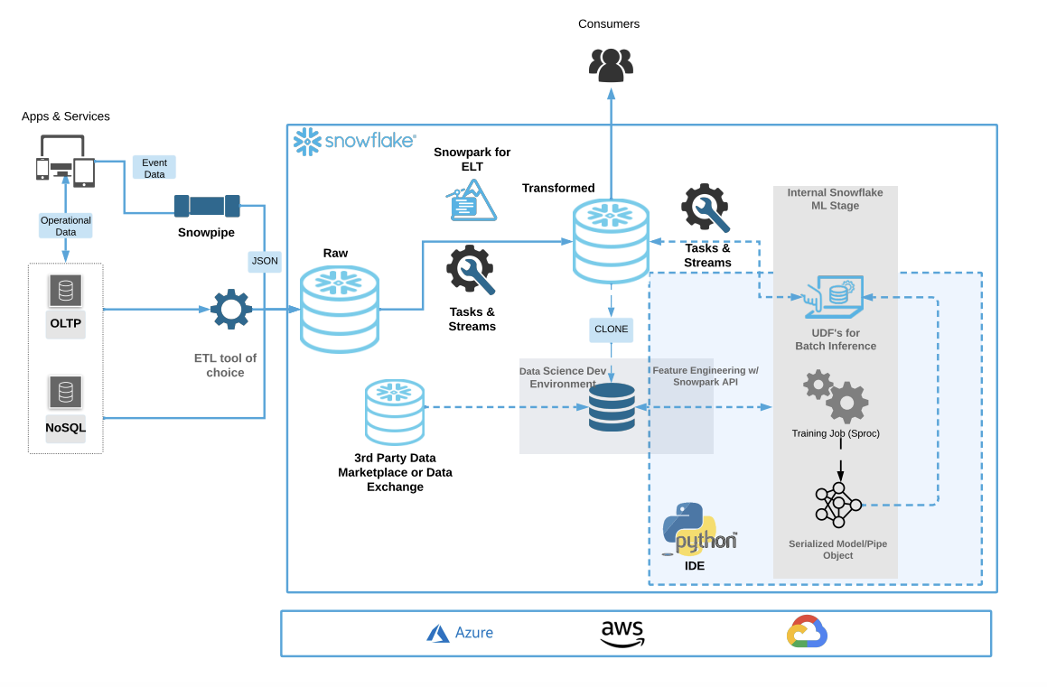
Hands-on Lab: Follow the flow within the blue box

Slide 15
Hands-on Lab Flow
Import required libraries
Establish secure connection to Snowflake
Load aggregated data from Snowflake into a Snowpark DataFrame
Transform data running lazy execution of Snowpark DataFrame functions
Run model training in Snowflake
Create/Call Stored Procedure to deploy model code in Snowflake
Create/Call Scalar User-Defined Function (UDF) for model inference in Snowflake
Create/Call Vectorized UDF using Batch API for model inference in Snowflake
Automate model (re)training using Snowflake Tasks

Slide 16
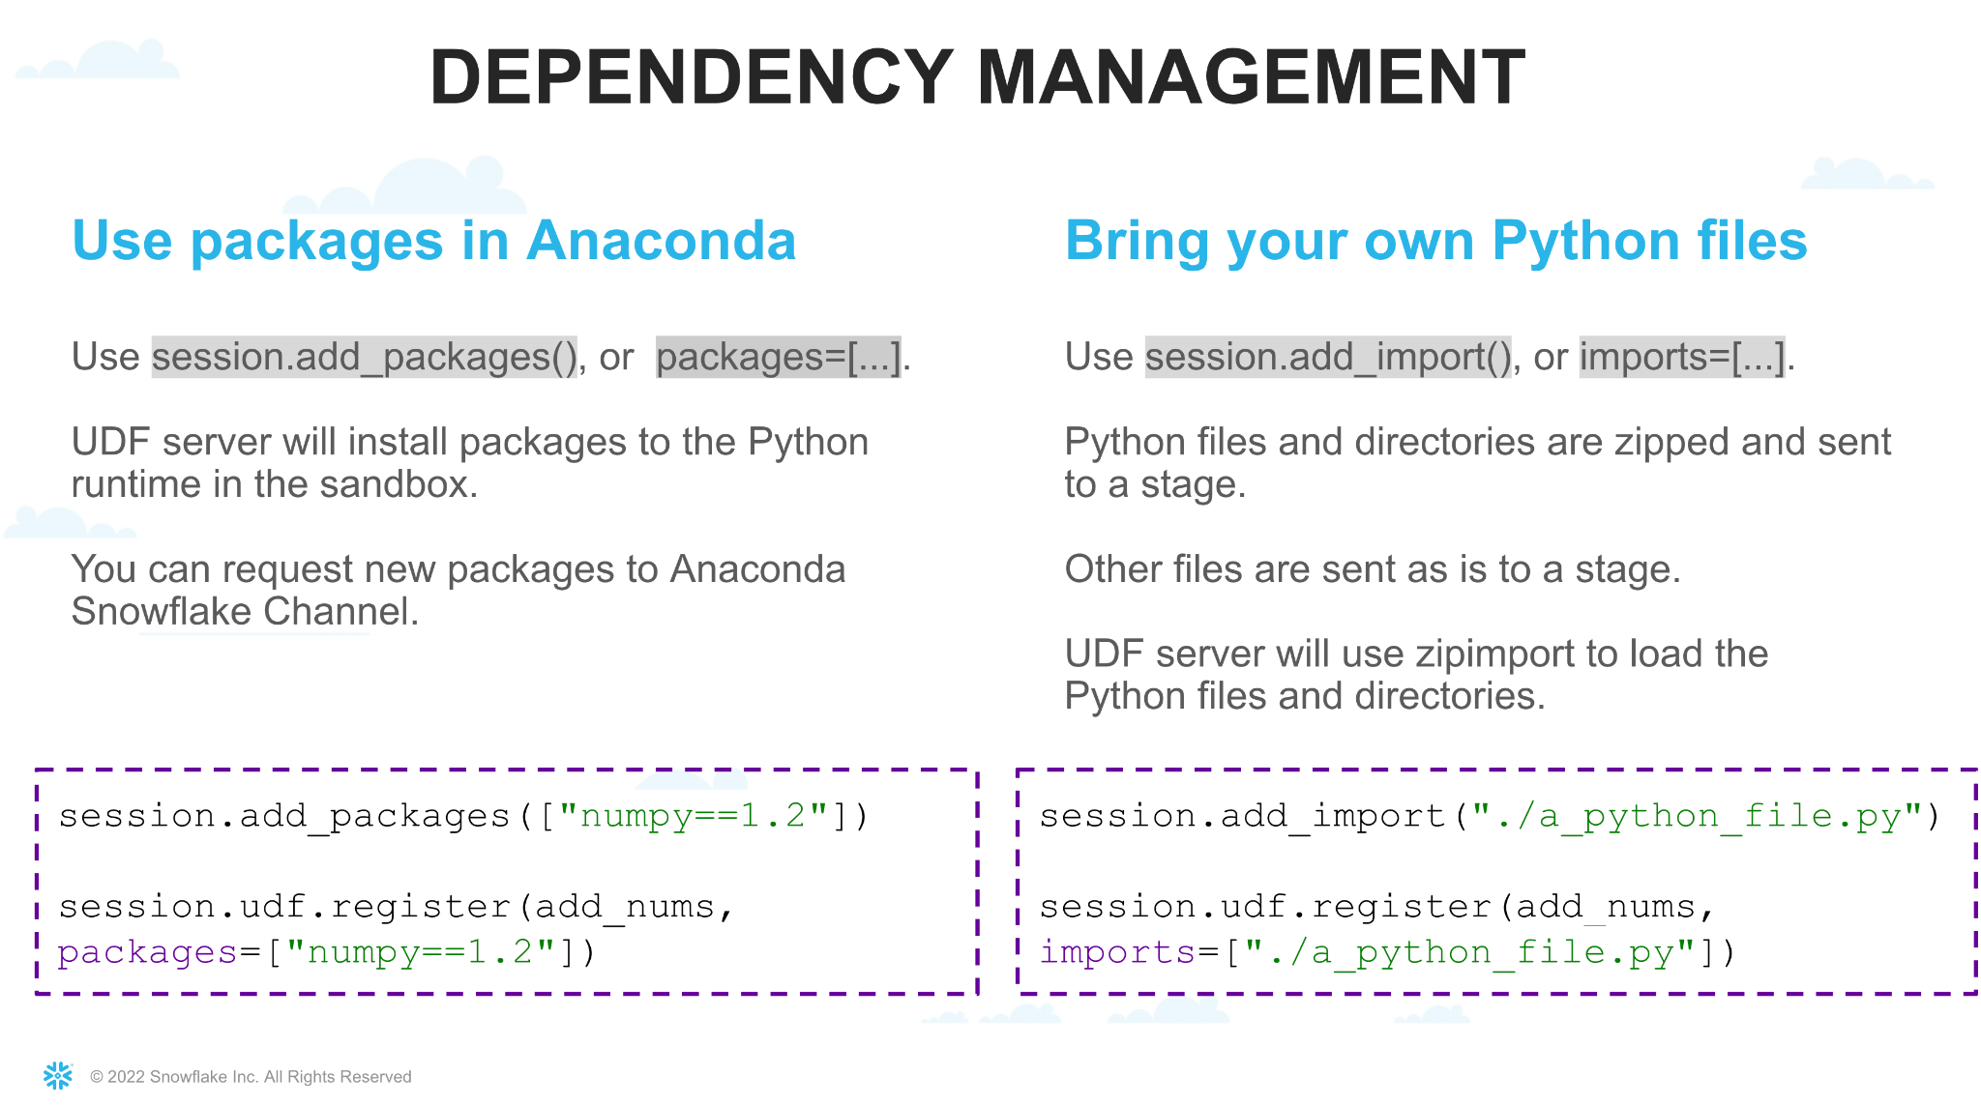
Snowpark Python Packages

Slide 17
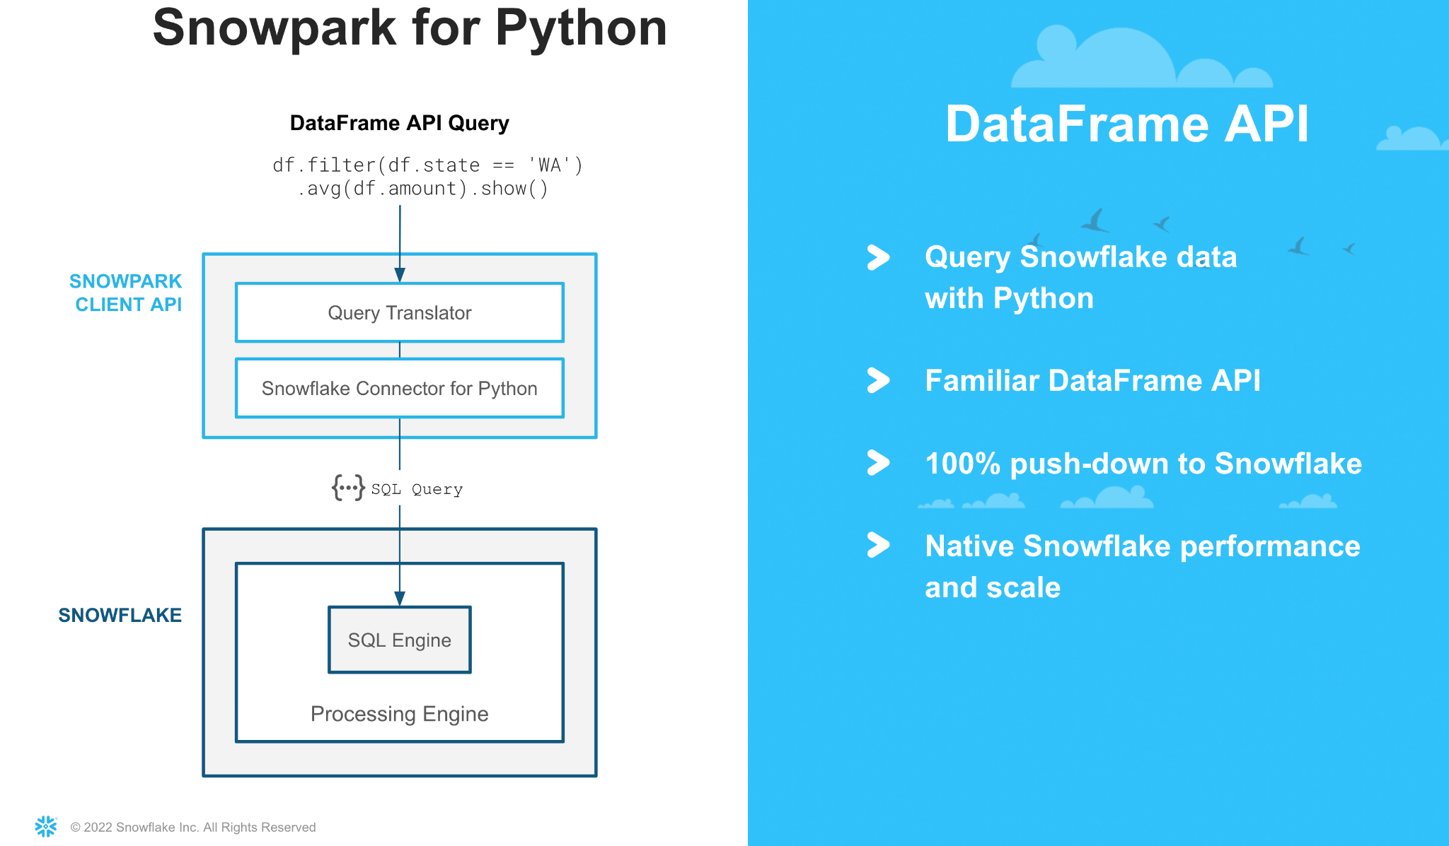
Snowpark DataFrame API

Slide 18
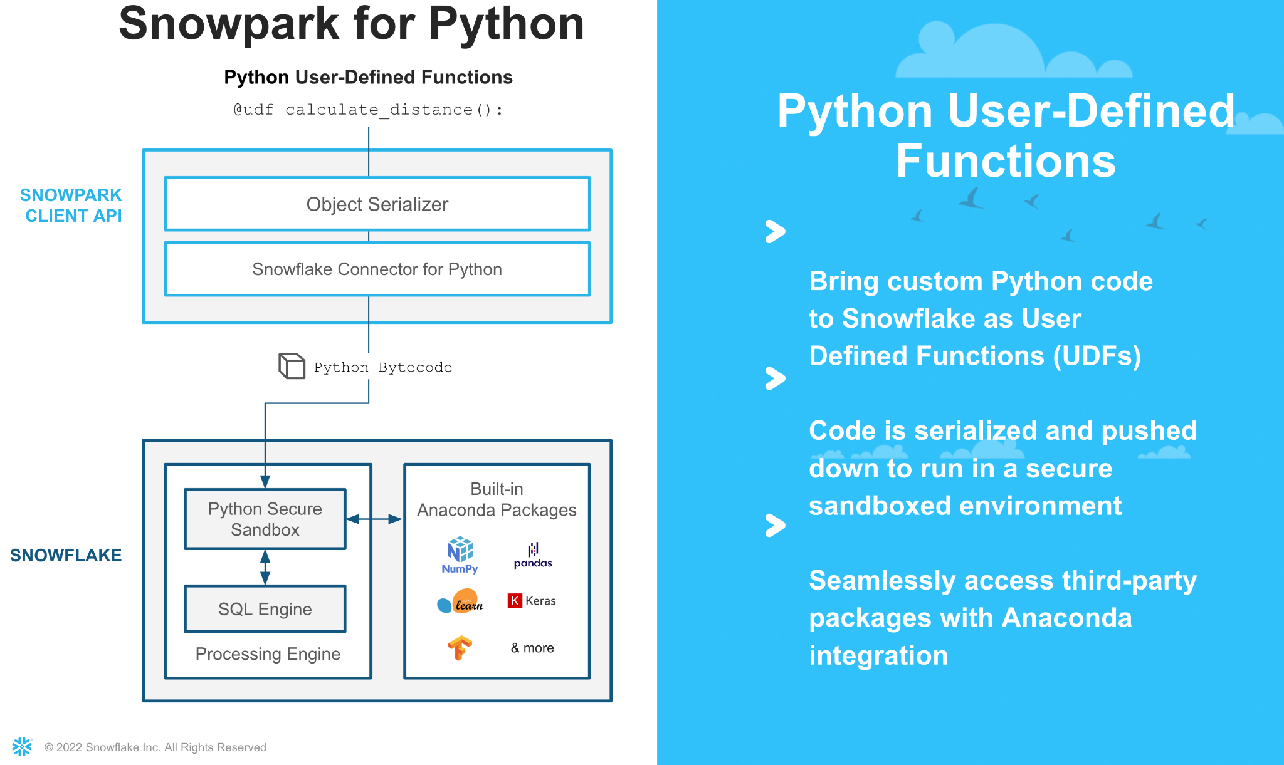
Snowpark Python UDFs

Slide 19
Modeling Scale Example: Check out the speed
TPCDS Data for Predicting Customer Lifetime Value
Raw Data
Historical Purchases / Transactions
Website activity
Profile details
Membership status
…
Features
per user id:
Sum_purchases_last_7_ days = 150
Count_items_bought_last_7_days = 22
Has_visited_site_last_30_ days = 1
Is_diamond_member = 1
Model
XG Boost
Prediction
Predict Customer Lifetime Value
($0 to $1M)
Business Action
Data Wrangling

Slide 20
Snowflake
Future State

Slide 21
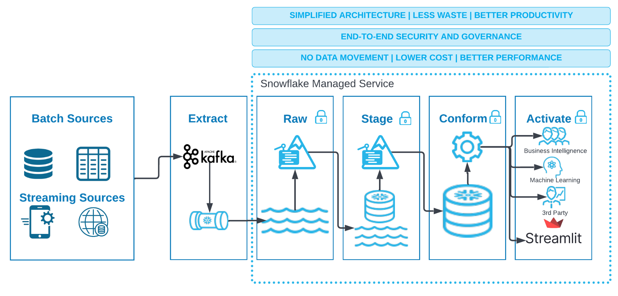
EXAMPLE FUTURE STATE
Notes:
COPY AND MOVE: https://lucid.app/lucidchart/5751d0f1-d855-4a54-9395-484a19be11b3/edit?viewport_loc=-705%2C-1353%2C3526%2C1272%2C9x.b0LT5~o8B&invitationId=inv_a37034b0-50fb-440e-b5f7-e86c893713d9
TKO Notes
This, again, is just an example. I’ve linked the lucid chart for your convenience
Make a future state of your own and share it back
Good branding, aligned with your customer is always a bonus

Slide 22


DEMO ARCHITECTURE
4
Ingestion Dashboard
5
Near Real-time
1
Automatic Schema Detection
2
Snowpark
Snowpipe
Analytics Users
Customer Data
Parquet
Tasks & Streams
Batch
EML
Raw
Transformed
Featured Store
Unstructured Data Support
Customer Churn Analysis
Customer Email
3
Java UDF
6
Serverless Tasks
Ingestion
Transformation
Delivery
Notes:
In the demo today we are going to build this in 6 simple steps.
I’m going to show you how you can build all this within snowflake data cloud using the new features and improvements.

Slide 23
Next Steps
Code Analysis and Assessment
POC Scoping and Plan
Test Snowpark
Performance
Total Cost of Ownership
Ease of Use
Simplicity and Efficiency
Governance & Security
Migration Readiness Assessment
Migration Discovery Workshop
Project Plan
Level of Effort estimates and scoping
Notes:
TKO Notes
Last slide of every deck is teeing up the next step and the next meeting
We recommend getting looped in with the technical resources at the customer and engaging in an Evaluation that makes sense for the customer use case and scenario

Slide 24
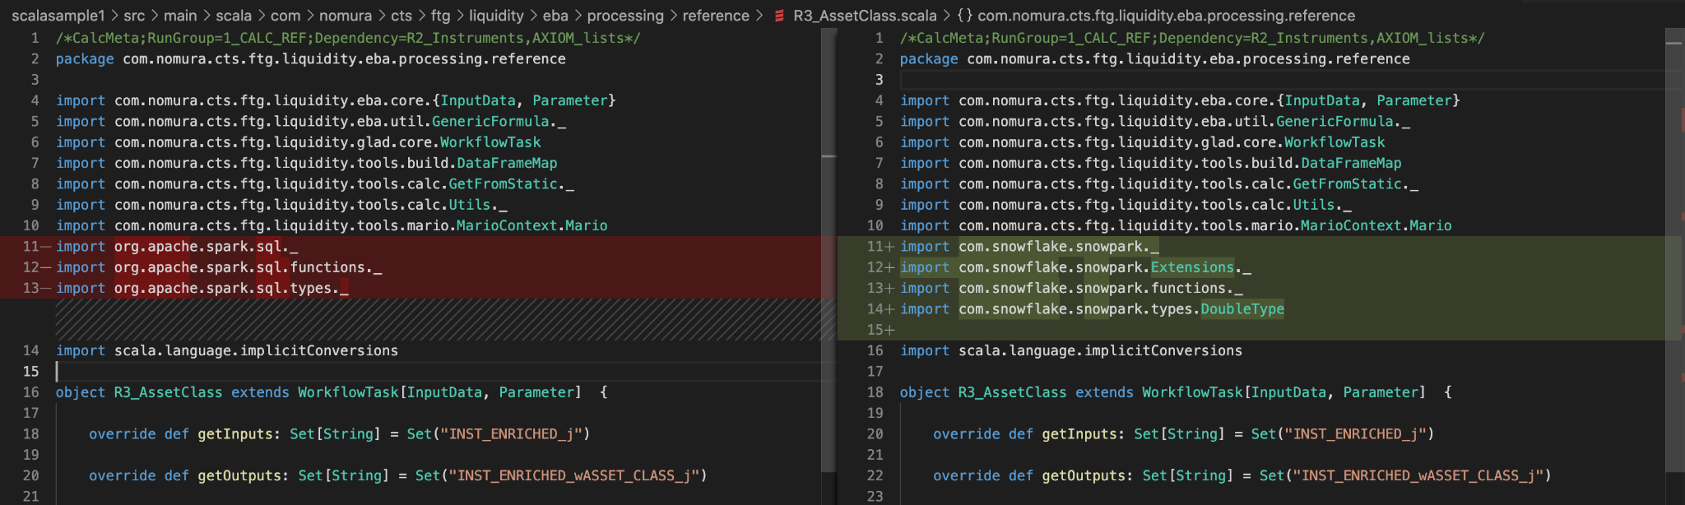
CODE COMPARISON
Swap Spark libraries for Snowpark libraries
Notes:
TKO Notes
Many customers have concerns regarding the code changes required to move to Snowpark. The next two slides are visual tools to help articulate what may need to change when moving from Spark or Pyspark dataframes to the Snowpark Dataframe API.
In this case, all that is needed is swapping out the libraries and everything else works seamlessly

Slide 25
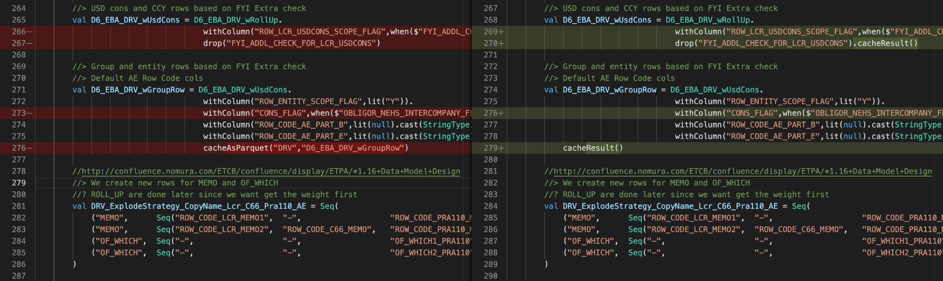
CODE COMPARISON CONT.
Logic stays the same, remove cacheAsParquet add cacheResult, literal handling etc.
Conversion automation is being developed for future use cases
Notes:
TKO Notes
In this scenario, we require minor updates to the code, itself. For example, with Snowpark, you don’t cache results as parquet, but rather cache the result directly in Snowflake as a table.
I will also mention that there are corner cases where more of the code needs refactoring and that is exactly what the evaluation is meant to surface: code interoperability, LOE to migrate to Snowpark, performance improvements of Snowpark, and the cost efficiencies.

